Slide 1
Course Scheduling Using Constraint Satisfaction
Manal Zneit
Jonathan Kelaty

Slide 2
Dataset
Scrapped Hunter’s Fall 2020 courses
Normalization
Wow, this data sucks!
Where’s the rest of it??
~2000 courses —> ~1200 normalized
Sections assigned relative time designations
i.e. morning, afternoon, evening
Preferences chosen randomly

Slide 3
Evaluation
Problems:
No 1:1 correspondence to Hunter’s actual schedule
Difficult to define objective evaluation parameters
Large datasets too large to evaluate subjectively
Full dataset (1200 courses) is over-constrained
Randomization and limited timeslot domain
Lack of data
Instructors’ preferences, room capacities, course demand
Tested using dataset of 500 courses
Scheduler on average completes in 30 seconds

Slide 4
Challenges/Future Work
Domain for timeslot
Difficult to define programmatically
Less granularity == more constrained
As granularity increases, so does time complexity
Online classes and alternative session periods
Multiple professors
Contextual scheduling for optimal schedule distribution
Core/major requirements
More constraints
More data!!

Slide 5
Visualization
Visualization tool built using React/Heroku
Frontend built using React and hosted on GH pages
Upload course and preferences data
View/interact with schedule
Backend built using Heroku
API request to run python scheduler and return schedule
Filter for constrained variables
Instructor and room assignments
Visualization tool

Slide 6
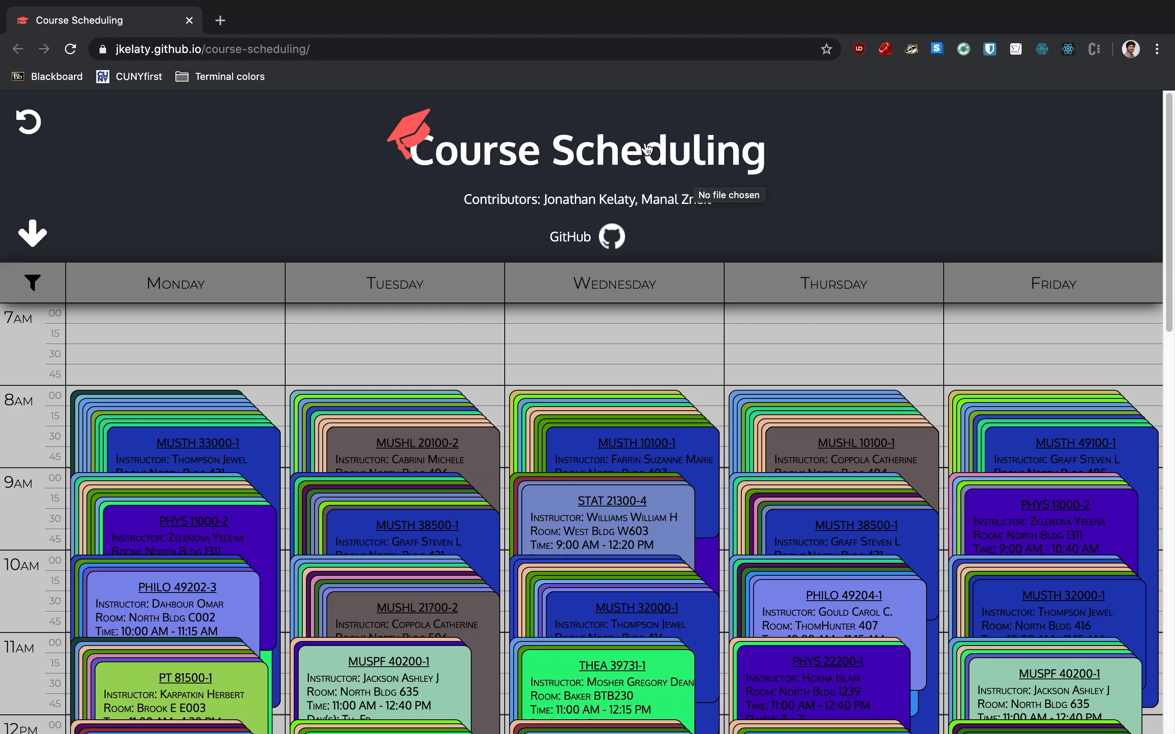
Visualization Demo

